Slide 1

Fancy Features in Asp.Net Core SignalR
Vladimir Georgiev
Software Development Lead @ Concep
VGeorgiev.org
Notes:
Здравейте. Аз съм Владо. Преди да започна искам да събера малко повече информация за вас.
.NET?
Real-Time?
SignalR?
Person types
.NET Core Developer using SignalR.Core – Familiar with almost everything
.NET Developer using SignalR – New SignalR
.NET Developer – Fancy Real time library
Java Developer – Real time communication with .NET

Slide 2
What is .NET Core?
Open Source
Cross-Platform – Windows, Mac, Linux
High-Quality – Rewritten from 0
Compatible - .NET Standart (.NET Framework, Xamarin, Mono)
Command-Line Tools
Includes ASP.NET Core Framework
Notes:
ASP.NET Core for building modern cloud based internet connected applications

Slide 3
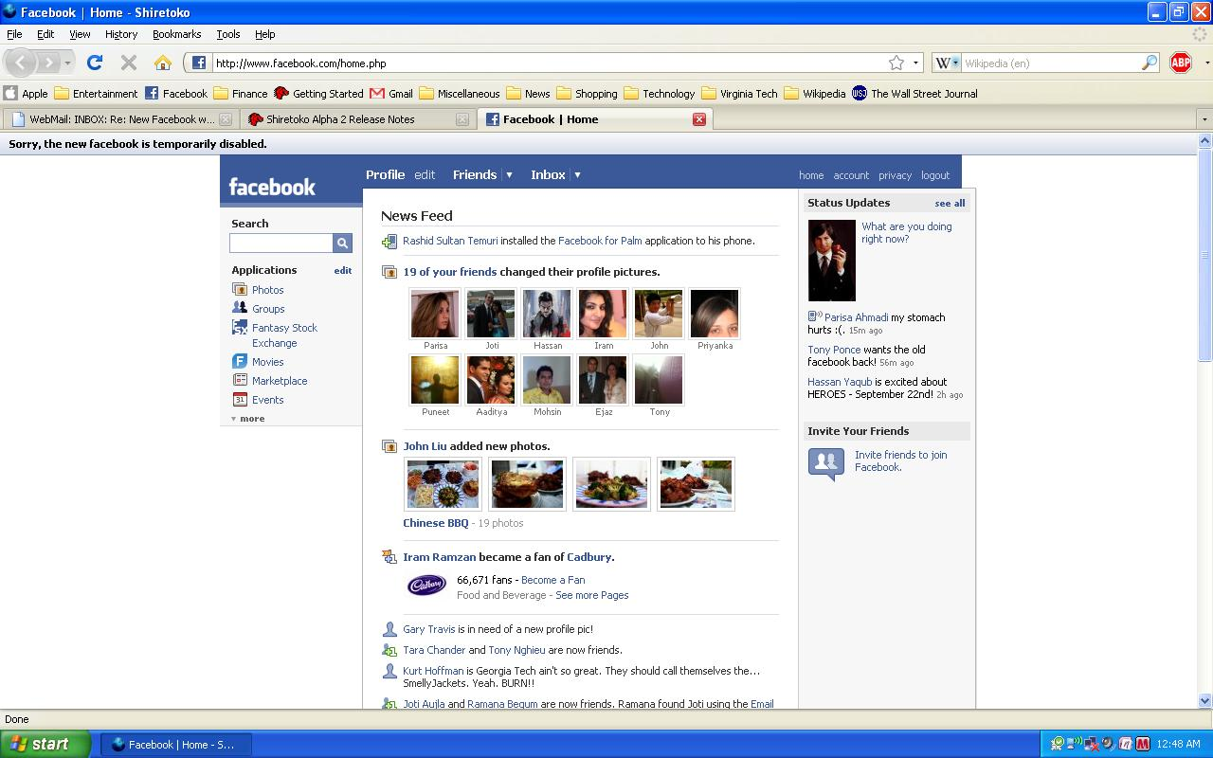
Notes:
Feed is not updated
Chat update on refresh
Check all app

Slide 4

Notes:
SoftUni notifications story

Slide 5
Real time web apps are not fancy anymore

Slide 6
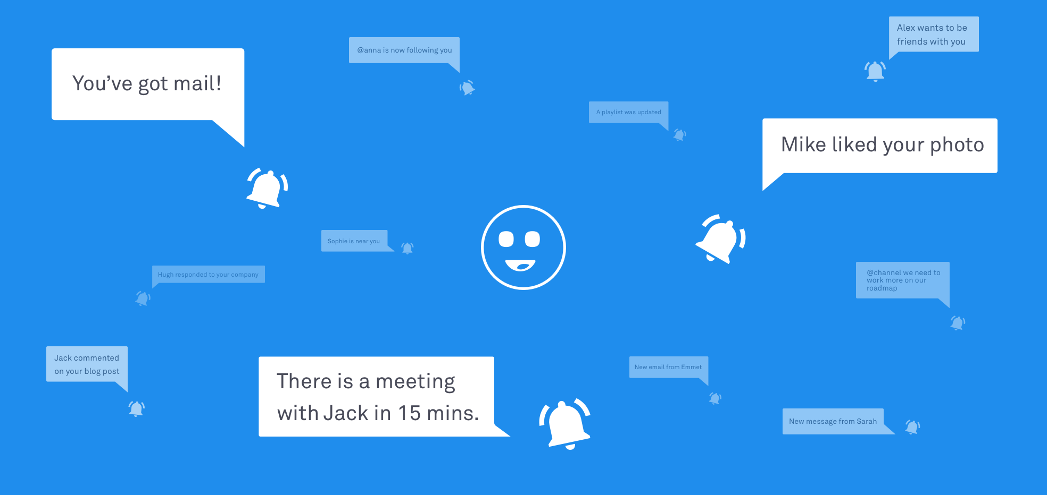
Notes:
Notifications are everywhere. That’s why I am here.

Slide 7
Users expect Real-Time

Slide 8


HTTP

Slide 9
HTTP

Slide 10
Long Polling & Server-Sent Events
connection
events
close connection
…

Slide 11
Web Sockets
open connection
close connection
Notes:
Не е ли неефективно да има много WS connections?

Slide 12






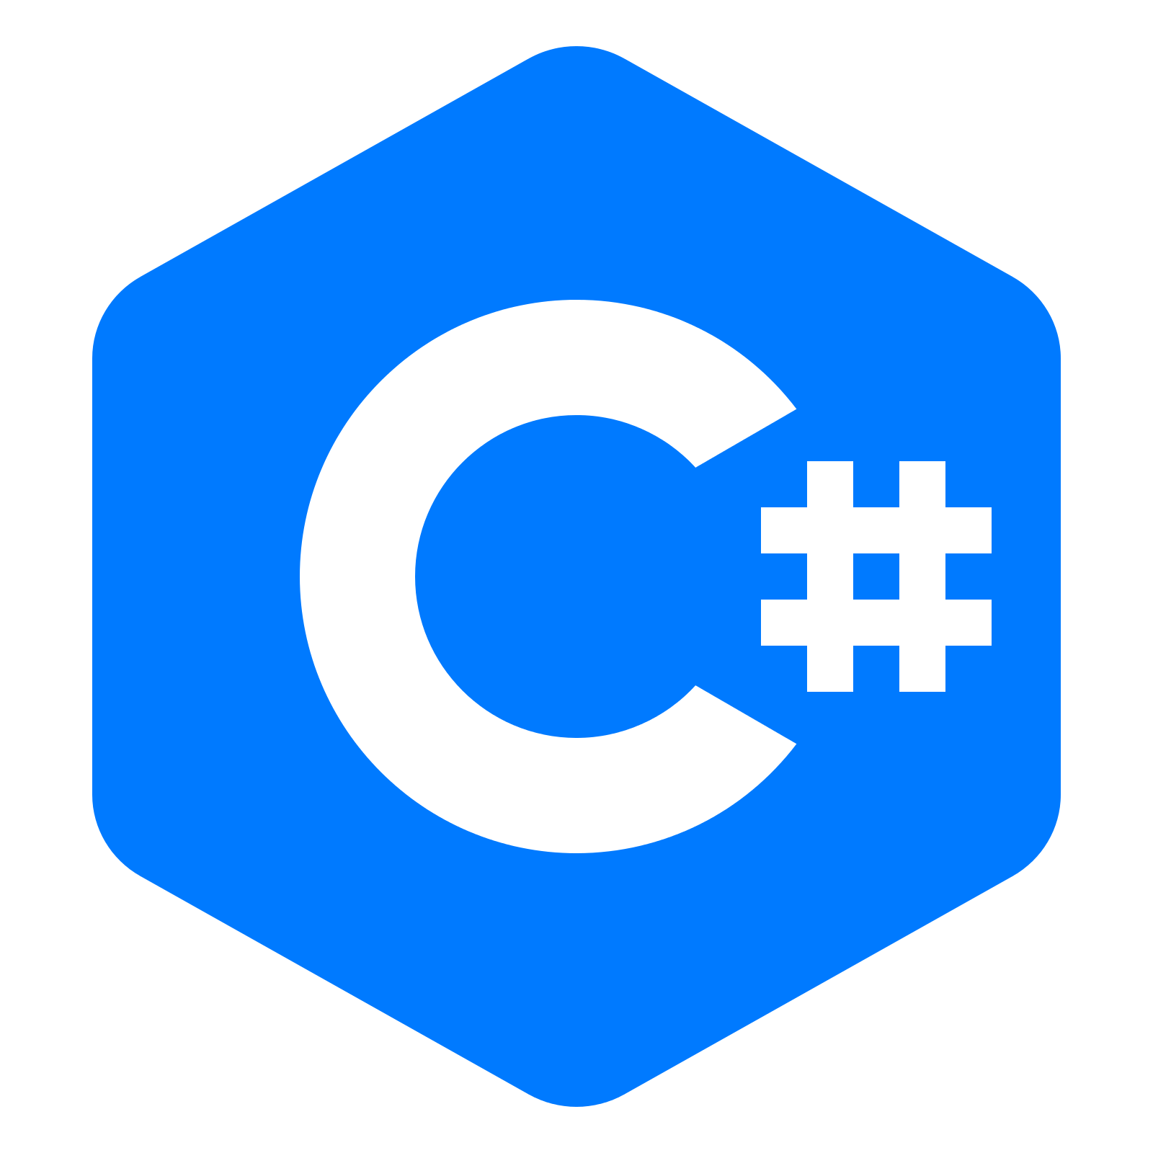
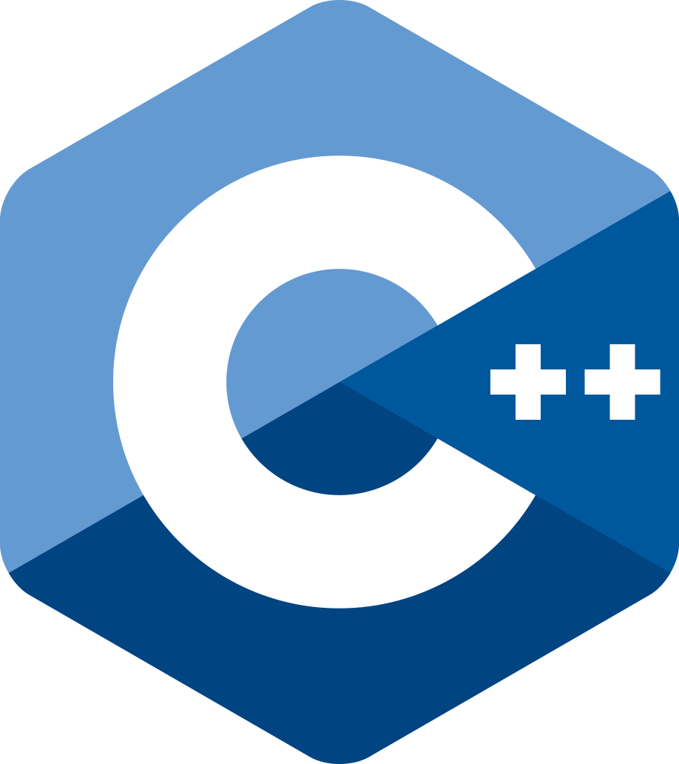
SignalR
Notes:
WebSockets
Server-Sent Events
Long Polling

Slide 13
SignalR Configuration
Use Visual Studio 2017 15.8+
Use .NET Core SDK 2.1+
Startup.cs
services.AddSignalR()
app.UseSignalR(routes =>
{
routes.MapHub<ChatHub>("/chatHub");
});
https://docs.microsoft.com/en-us/aspnet/core/tutorials/signalr
Notes:
1. Use latest Visual Studio and .NET Core SDK
3. Configure SignalR
4. Create SignalR Hub
5. Add the SignalR client library
6. Client side code

Slide 14
SignalR Hub
ChatHub.cs
public class ChatHub : Hub
{
public async Task SendMessage(string user, string message)
{
await Clients.All.SendAsync("receiveMessage", user, message);
}
}

Slide 15
Client-side Code
chat.js
var connection = new signalR.HubConnectionBuilder()
.withUrl("/chatHub").build();
connection.on("receiveMessage", function (user, message) {
// Append the message to DOM
});
connection.start();
document.getElementById("sendButton").addEventListener("click",
function (event) {
connection.invoke("SendMessage", user, message);
});

Slide 16


JSON & MessagePack Protocols

Slide 17
JSON & MessagePack Protocols
Install package Microsoft.AspNetCore.SignalR.Protocols.MessagePack
services.AddSignalR().AddMessagePackProtocol();
<script src="~/lib/signalr/signalr.js"></script>
<script src="~/lib/msgpack5/msgpack5.js"></script>
<script src="~/lib/signalr/signalr-protocol-msgpack.js"></script>
var connection = new signalR.HubConnectionBuilder()
.withHubProtocol(new signalR.protocols.msgpack.MessagePackHubProtocol())
.withUrl("/chatHub").build();

Slide 18

Inject IHubContext

Slide 19
Injecting HubContext everywhere
public class ChatController : ControllerBase
{
private readonly IHubContext<ChatHub> chatHub;
public ChatController(IHubContext<ChatHub> chatHub)
{
this.chatHub = chatHub;
}
[HttpGet("/Message")]
public Task SendMessage(string message)
{
return this.chatHub.Clients.All.SendAsync("receiveMessage", "Controller", message);
}
}

Slide 20

Strongly-Typed Hubs

Slide 21
Dynamic & magic string calls
ASP.NET SignalR
Asp.Net Core SignalR
Clients.All.broadcastMessage(name, message);
Clients.All.SendAsync("receiveMessage", user, message);

Slide 22
Strongly Typed Hubs
public class StronglyTypedHub : Hub<IChatClient>
{
public async Task SendMessage(string user, string message)
{
await Clients.All.ReceiveMessage(user, message);
}
}
public interface IChatClient
{
Task ReceiveMessage(string user, string message);
}

Slide 23

Authentication & Authorization

Slide 24
Authentication & Authorization
Cookie authentication
Bearer token authentication
[Authorize]
public class ChatHub : Hub
{
[Authorize("MyAuthorizationPolicy")]
public async Task Send(string message)
{
// send a message to all users...
}
}

Slide 25

Streaming

Slide 26
Streaming
StreamingHub.cs
private List<string> words = { /* some words */ };
public ChannelReader<string> ShowMeTheWords(int delay)
{
var channel = Channel.CreateUnbounded<string>();
_ = WriteItemsAsync(channel.Writer, delay);
return channel.Reader;
}
private async Task WriteItemsAsync(ChannelWriter<string> w, int delay)
{
for (var i = 0; i < words.Count; i++)
{
await writer.WriteAsync(words[i]);
await Task.Delay(delay);
}
writer.Complete();
}

Slide 27
Streaming
StreamingHub.cs
private List<string> words = { /* some words */ };
public ChannelReader<string> ShowMeTheWords(int delay)
{
var channel = Channel.CreateUnbounded<string>();
_ = WriteItemsAsync(channel.Writer, delay);
return channel.Reader;
}
private async Task WriteItemsAsync(ChannelWriter<string> w, int delay)
{
for (var i = 0; i < words.Count; i++)
{
await writer.WriteAsync(words[i]);
await Task.Delay(delay);
}
writer.Complete();
}

Slide 28
Streaming
StreamingHub.cs
private List<string> words = { /* some words */ };
public ChannelReader<string> ShowMeTheWords(int delay)
{
var channel = Channel.CreateUnbounded<string>();
_ = WriteItemsAsync(channel.Writer, delay);
return channel.Reader;
}
private async Task WriteItemsAsync(ChannelWriter<string> w, int delay)
{
for (var i = 0; i < words.Count; i++)
{
await writer.WriteAsync(words[i]);
await Task.Delay(delay);
}
writer.Complete();
}

Slide 29
Streaming
StreamingHub.cs
private List<string> words = { /* some words */ };
public ChannelReader<string> ShowMeTheWords(int delay)
{
var channel = Channel.CreateUnbounded<string>();
_ = WriteItemsAsync(channel.Writer, delay);
return channel.Reader;
}
private async Task WriteItemsAsync(ChannelWriter<string> w, int delay)
{
for (var i = 0; i < words.Count; i++)
{
await writer.WriteAsync(words[i]);
await Task.Delay(delay);
}
writer.Complete();
}

Slide 30
Streaming
Streaming.js
var connection = new signalR.HubConnectionBuilder() .withUrl("/streamingHub").build();
connection.start();
connection.stream("ShowMeTheWords", 750).subscribe({
next: (item) => { /* render item */ },
complete: () => { /* complete */ },
error: (err) => { /* show error */ }
});

Slide 31
Summary
SignalR
MessagePack
HubContext
Strongly-Typed Hubs
Authentication & Authorization
Streaming
Notes:
SignalR vs SignalR Core
No more jQuery
No Reconnection
Custom routes for hubs
Binary data support
Future features
TCP/IP Support
Client-side Typed Hubs
More clients: Java, C++, iOS

Slide 32

Notes:
Try it out!

Slide 33

Use Real-Time
Notes:
Because you will make clients happy!

Slide 34

Vladimir Georgiev
VGeorgiev.org

